Slide 1


Introduction to
Robotic Process Automation
AUTOMATED STUDENT COURSE REGISTRATION AND DOCUMENTATION BOT
2116220701040
BHANU PRIYA S
Mrs. J. JINU SOPHIA,
ASSISSTANT PROFESSOR(SG)
COMPUTER SCIENCE OF ENGINEERING

Slide 2
Abstract
The Student Course Registration and Documentation Bot is a project that creates personalized PDF files for students using either manual input or data from an excel file. It collects student details, fills a Word template with the information, and converts it into a PDF. These PDFs are then organized and sent to the students' email addresses. The project uses UiPath to handle tasks like taking input, reading Excel files, editing Word documents, and sending emails, making the process fast and efficient.

Slide 3
Need for the Proposed System
Automation of Tasks: Manual creation and distribution of student documents is slow and inefficient. The system automates these tasks to save time and effort.
Ease of Distribution: Automates the process of sending documents via email, reducing the need for manual follow-ups.
Error Reduction: Manual data entry can lead to errors, while automation ensures accuracy in document generation.
Improved Productivity: Frees up staff time for more critical tasks by eliminating repetitive work.
Cost Efficiency: Saves resources by reducing paper usage and minimizing manual work.

Slide 4
Advantages of the Proposed System
1. Time-Saving: Automates tasks like document creation and email sending, reducing the time spent on manual work.
2. Efficiency: Handles large volumes of student data quickly and consistently.
3. Consistency: Produces documents in a uniform format, maintaining a professional standard.
4. Cost-Efficient: Reduces dependency on paper-based processes and manual labor, saving resources.

Slide 5
Main Objective
The main objective of this project is to automate the process of generating and distributing personalized student documents efficiently and accurately. By using input from manual entry or Excel files, the system creates professional PDF documents, organizes them systematically, and sends them directly to students' email addresses. This reduces manual effort, ensures consistency, minimizes errors, and enhances productivity in managing student records and communication.

Slide 6
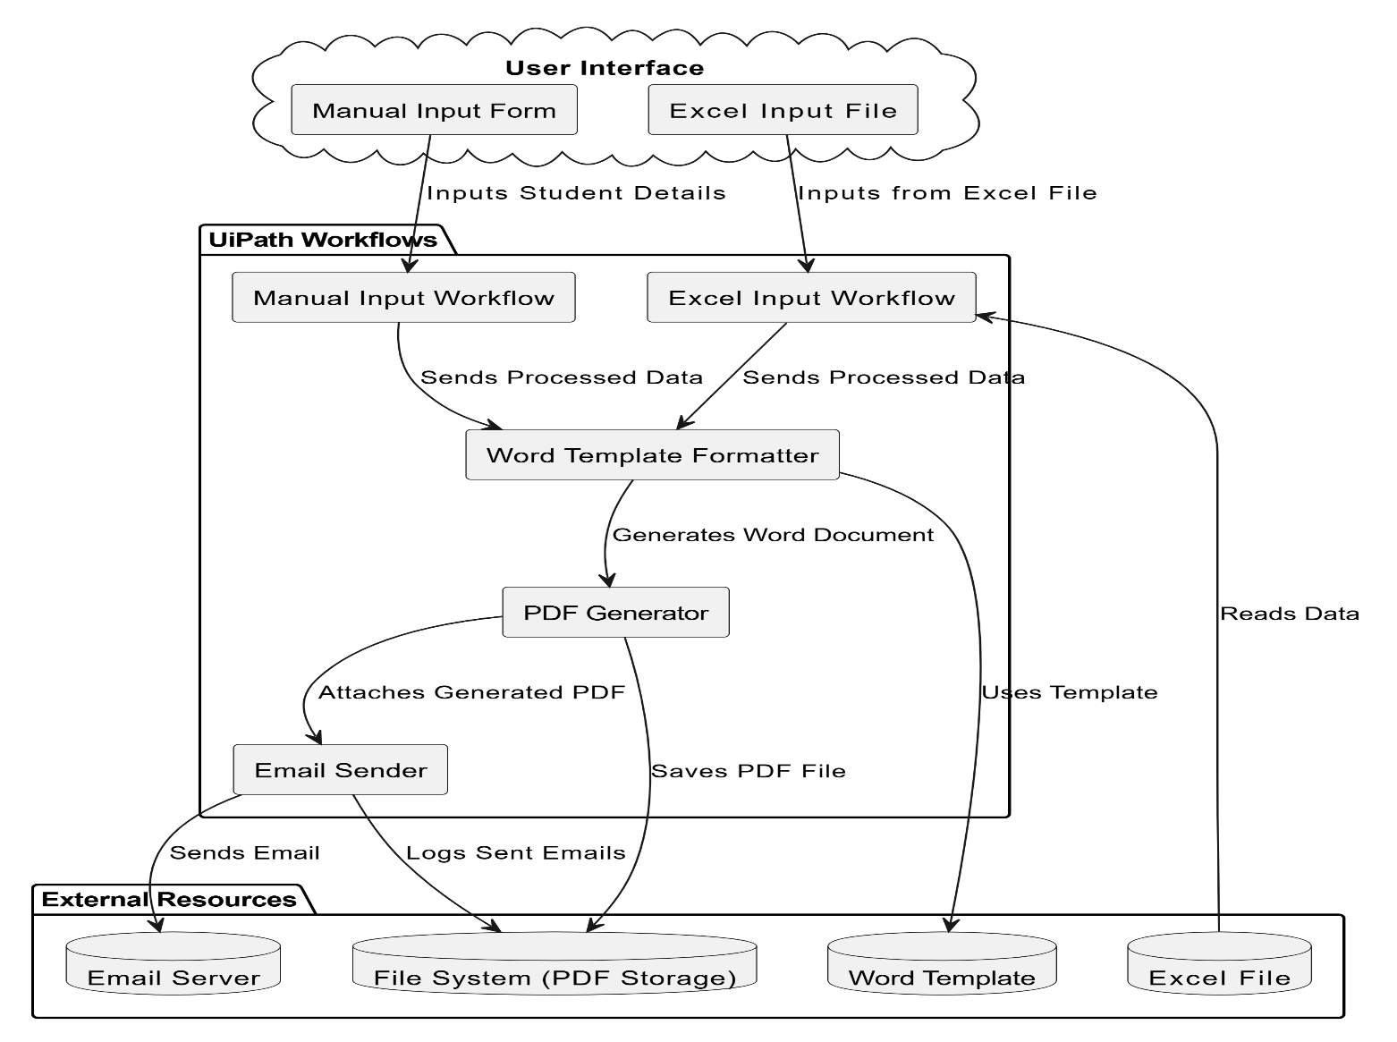
Architecture

Slide 7
System Requirements
Software:
UiPath Studio (Version 24.10.5 or above)
Microsoft Office: Word, Excel
PDF Reader
SMTP Configuration
Operating System : Windows 10 or above
Hardware:
Processor: Intel i3 or above
RAM: 4 GB minimum
Internet Connection

Slide 8
Functional Description
Module 1: Manual Input
This module allows users to manually enter student details through input dialogs in UiPath. The collected information is used to populate a predefined Word template, which is then converted into a personalized PDF file. The generated PDF is saved in a specified folder for further use or distribution.
Module 2: Excel Input
This module processes student details from an Excel file. Each row of the file is read and used to dynamically fill the Word template. A personalized PDF is generated for each student and saved in an organized folder structure, ready for distribution.

Slide 9
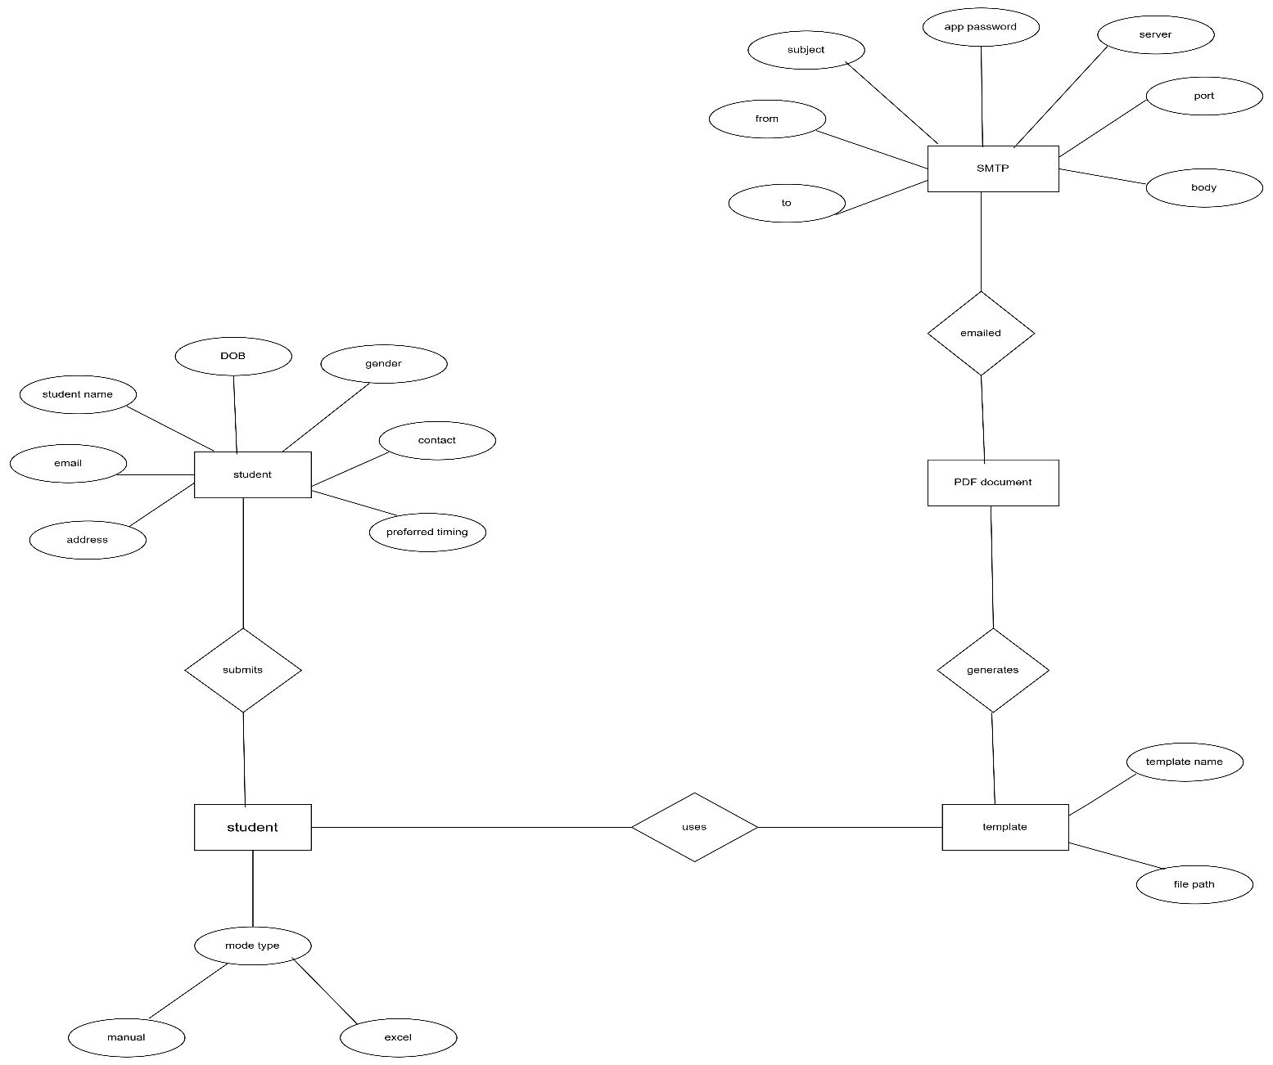
Table Design
ERD

Slide 10
Process Design
Main Process
Input Collection: Gather student information (either from manual input or an Excel file).
Data Validation: Make sure the input data is correct and complete.
PDF Generation: Create the PDF document with the student’s details.
Email Creation: Write an email with the PDF attached.
Email Sending: Send the email to the student with the attached PDF.

Slide 11
Process Design
Sub Process
1.Input Collection:
Manual Input: User enters student details (e.g., name, email).
Excel Input: User uploads an Excel file, and the system extracts student data.
2.Data Validation:
Check for Empty Fields: Ensure that required fields are filled (e.g., name, email).
3.PDF Generation:
Create Template: Choose or design a template for the student’s details.
Fill Data: Populate the template with student information.
Generate PDF: Create the final PDF.

Slide 12
Process Design
4.Email Creation:
Compose Email: Write the subject and message.
Attach PDF: Attach the generated PDF to the email.
5.Email Sending:
Send Email: Use an email system to send the composed email with the attached PDF to the student.

Slide 13
Implementation
Implementation of Module 1
Module 1 focuses on gathering student details, which can be done by manual input.
In this part of the module, the system allows the user to manually enter details of the student, such as:
Full Name
DOB
Gender
Email ID
Phone Number
Other personal details

Slide 14
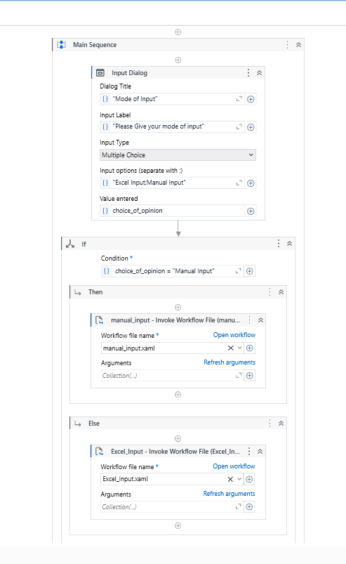
Implementation Screenshots

Slide 15
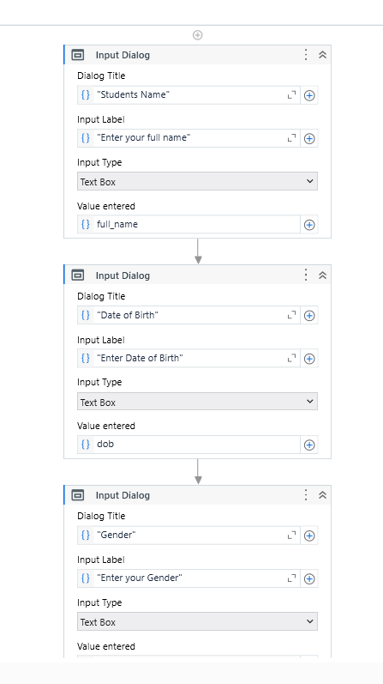
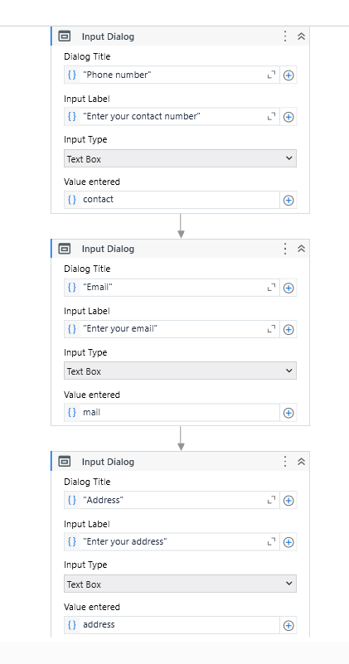
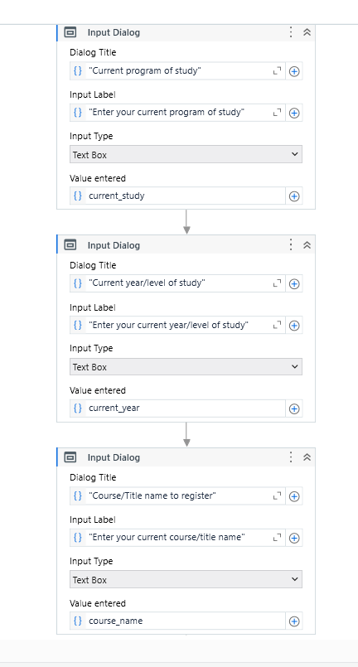

Slide 16
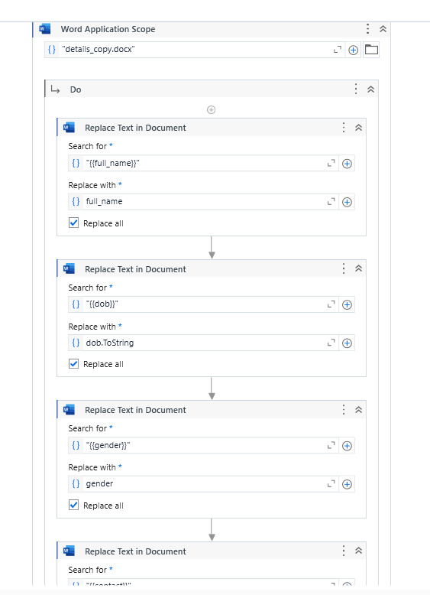
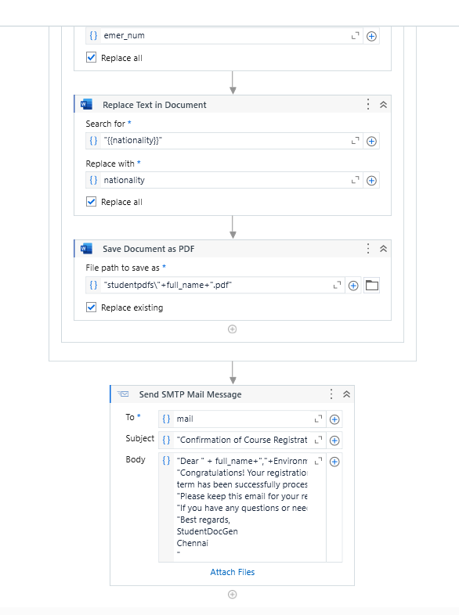

Slide 17
Implementation
Implementation of Module 2
In this part, the system allows the user to upload an Excel file containing student data. The system will then extract this data and use it to generate the student PDF.

Slide 18
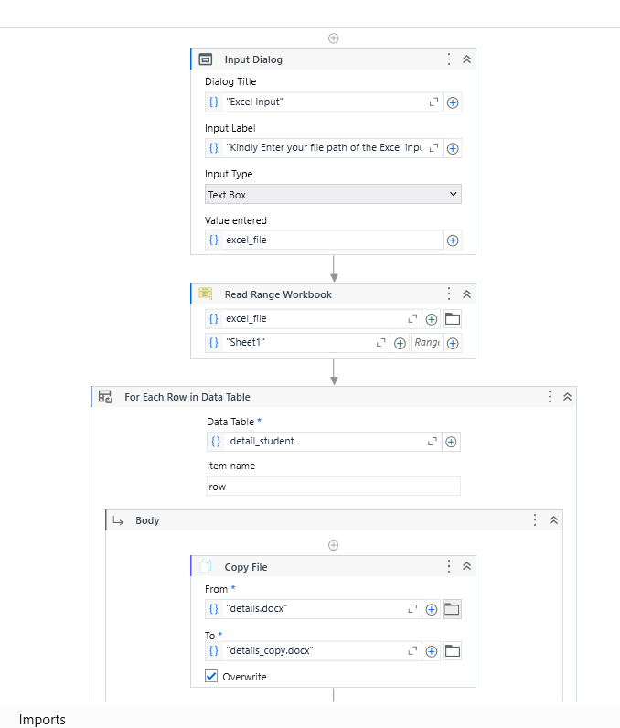
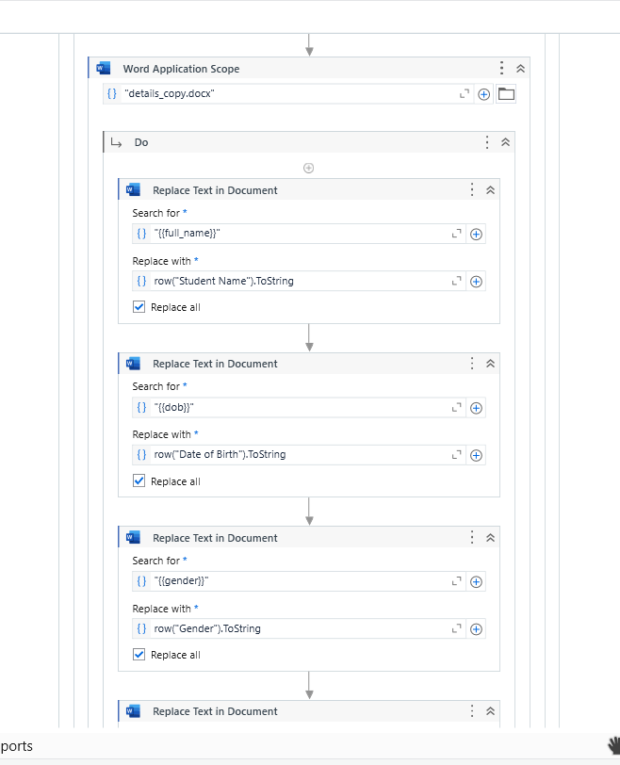
Implementation Screenshots

Slide 19
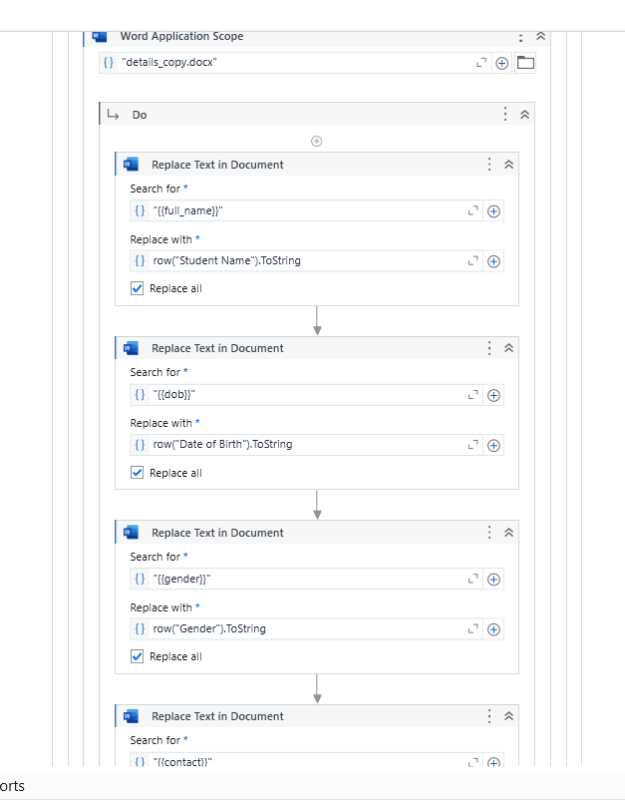
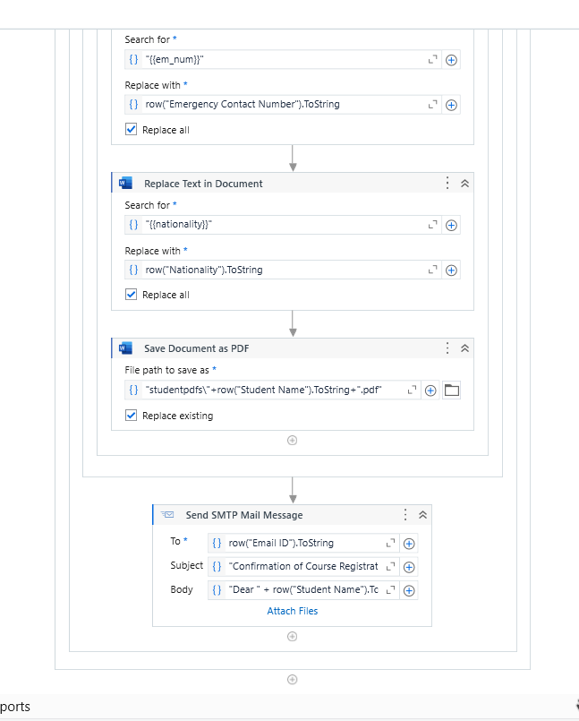

Slide 20
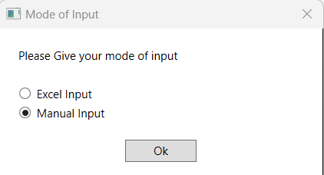
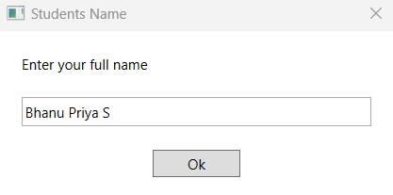
Testing
Module 1: Manual Input and Validation
Tests: Enter valid inputs for all required fields (e.g., name, email, course,gender,etc).
Expected Results: The system accepts the data without errors and proceeds to the next step.

Slide 21
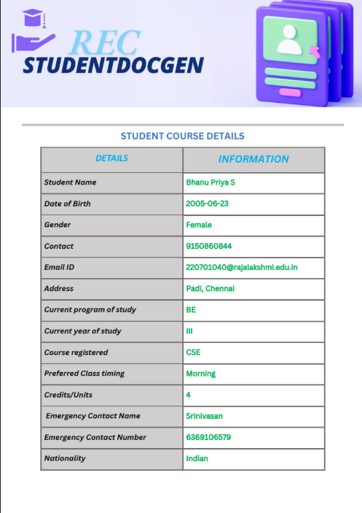
Output

Slide 22
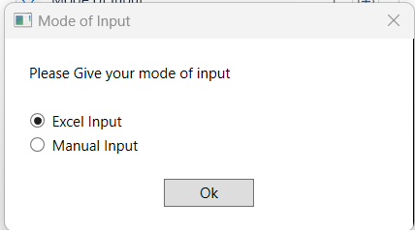
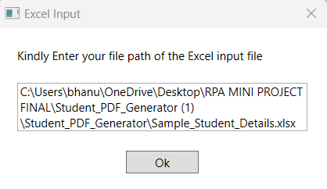
Testing
Module 2: Excel File Upload and Processing
Tests: Upload an Excel file with all required fields filled correctly (e.g., name, email, roll number).
Expected Results: The system successfully reads and processes the data from the file without showing any errors, confirming that the data is valid.

Slide 23
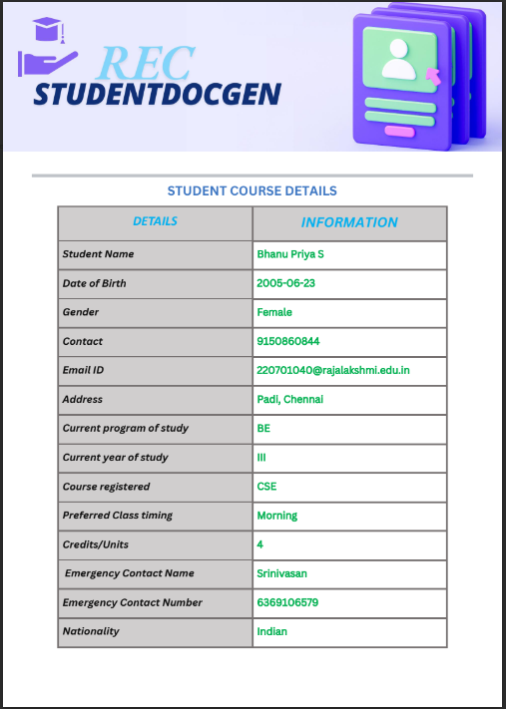
Output

Slide 24
Conclusions
The Student PDF Generator project successfully automates the process of collecting student details, processes it , generates personalized PDFs, and sending them via email. This system simplifies what was once a manual and time-consuming task, making it faster, more efficient. By offering both manual input and Excel upload options, it ensures flexibility for users to handle data in their preferred way. The automated PDF creation ensures uniformity in document formatting, while email integration adds convenience by delivering the results directly to the recipients.

Slide 25
Future Enhancement
Cloud Storage Integration
The system can be improved to save the generated PDFs directly to cloud storage like Google Drive or OneDrive. This makes it easy to access, share, and keep documents safe as a backup.
Support for Multiple Languages
In the future, the system can create PDFs and send emails in different languages. This will help students from various regions and make the system more user-friendly for everyone.

Slide 26
References
https://academy.uipath.com/courses/pdf-automation-in-studio-v202010
https://academy.uipath.com/

Slide 27
Queries

Slide 28
Demonstration

Slide 29
Thank You

